Slide 1

File and Printer sharing in Windows NT Environment
NATIONAL INSTITUTE OF ELECTRONICS AND INFORMATION TECHNOLOGY
Birla Farms, Bada Phull, Ropar
NIELIT ‘O’-Level
IT Tools and Network basics

Slide 2
Virtual Reality

Slide 3
Index
Virtual Reality
Hardware used in Virtual Reality
Input Devices
Output Devices
Advantages and Disadvantages of Virtual reality

Slide 4
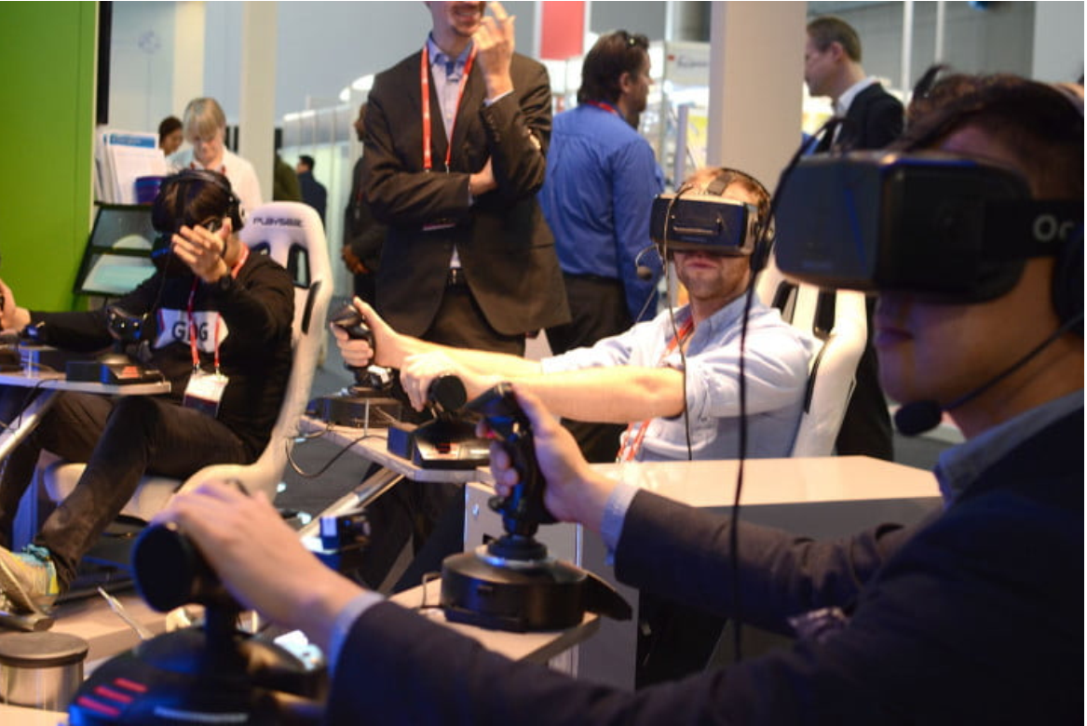
Virtual Reality

Slide 5
Virtual Reality
Virtual reality technology seeks to create a realistic three-dimensional image or environment that a human can perceive as real, and even interact with in realistic ways using VR headsets and controllers.
Virtual reality is seeing and feeling an imaginary world, rather than the real one. The imaginary world is a simulation running in a computer. The sense data is fed by some system to our brain.
A medium composed of interactive computer simulations giving users the feeling of being present in the simulations.
This simulation is a computer generated 3D environment that allows the user to enter and interact with alternate realities .
VR in devices like headsets is created entirely by a mixture of hardware and software.
It tends to be a more difficult prospect as the complete environment is simulated, hence realism is harder to attain.

Slide 6
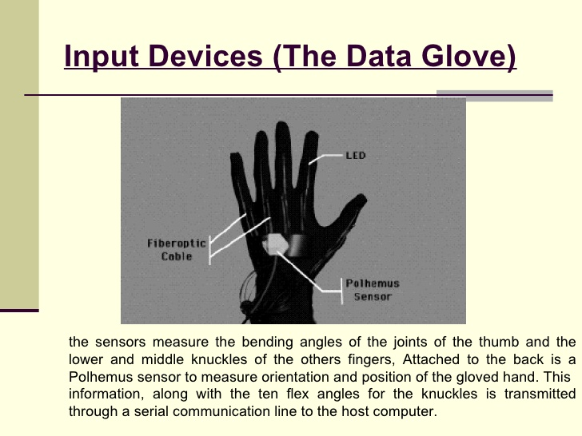
Hardware Used in Virtual Reality
Input Devices:
A variety of input devices allow the user to navigate through a virtual environment and to interact with virtual objects.
Directional sound, tactile and force feedback devices, voice recognition and other technologies are being employed to enrich the immersive experience and to create more sensualized interfaces.

Slide 7
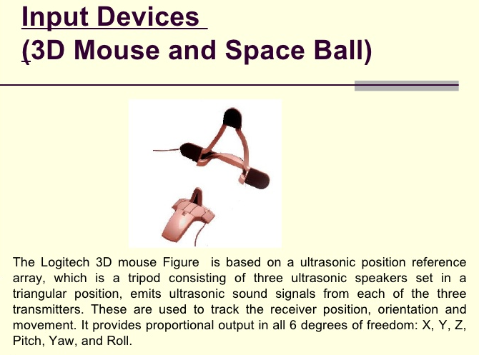
Hardware Used in Virtual Reality

Slide 8
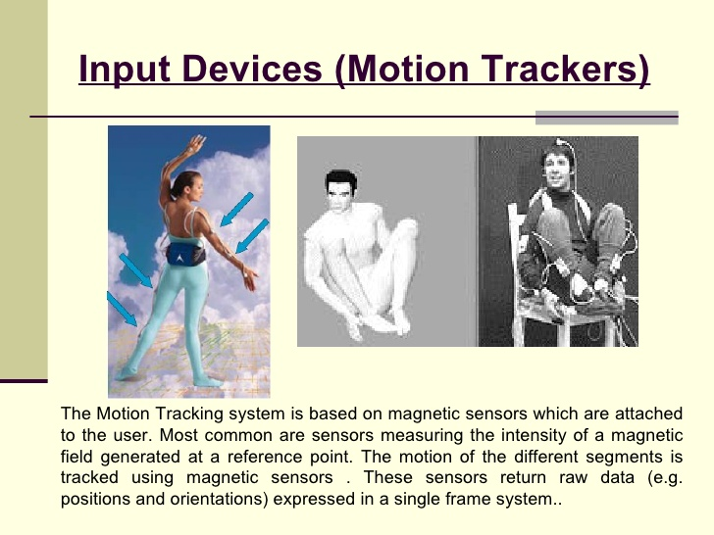
Hardware Used in Virtual Reality

Slide 9
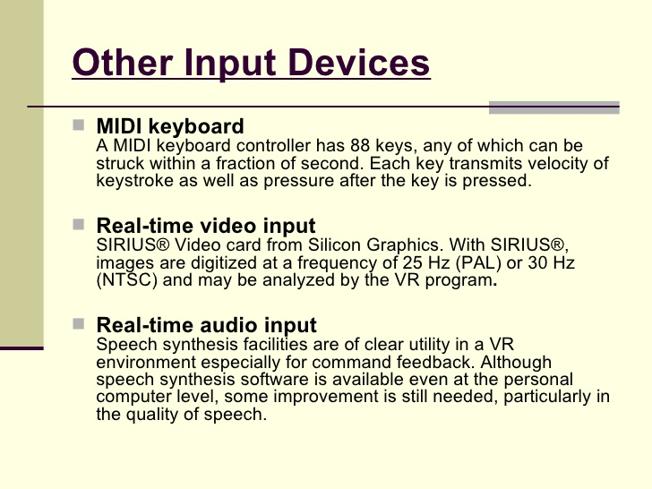
Hardware Used in Virtual Reality

Slide 10
Hardware Used in Virtual Reality
Output Devices:
Headset
The most used VR product is VR headset any many versions are available from top tech brands like Google and Sony, each with their own unique approach
These headsets are easy to divide into categories based on the hardware they are designed to work with.
Larger, high-end headsets are typically designed to work with PCs that have been enabled to run VR software.
Headsets for other machines like game consoles, notably PlayStation VR.
Stand-alone headsets that include all necessary hardware onboard.
Cheaper headsets to work with smartphones, with a slot in the headset to position the smartphone screen at the right distance from the eyes. These headsets are made to work with VR apps and a Google Cardboard

Slide 11
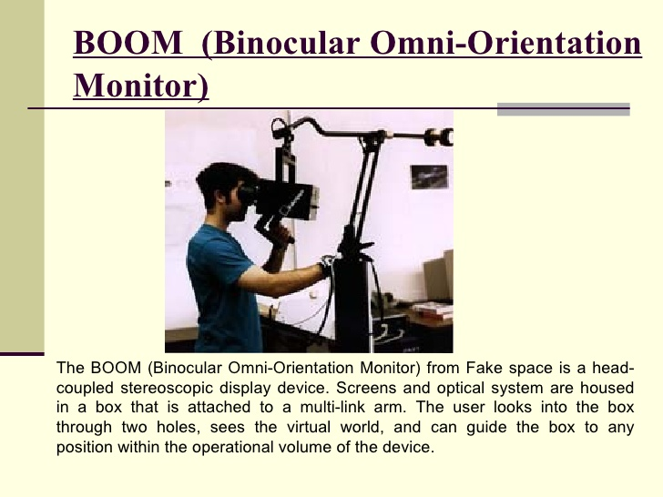
Hardware Used in Virtual Reality

Slide 12
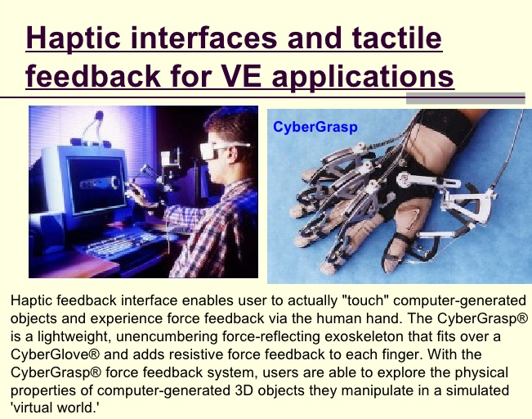
Hardware Used in Virtual Reality

Slide 13
Advantages and Disadvantages of VR
Advantages:
Virtual reality creates a realistic world
Enables the user to explore places
A user can experience an artificial environment
Makes education more easy and comfortable
Disadvantages:
The equipment used in virtual reality are very expensive
It consists of complex technology
In virtual reality we cannot move by our own like in the real world

